Slide 1
Decision tree methods for psychological assessment An introduction to classification and regression trees, model-based trees, and trees for longitudinal and multilevel data
ECPA15, Brussels, Belgium, 2019 Marjolein Fokkema, Leiden University

Slide 2
Today’s workshop
Goal: Short introduction to decision-tree methods
How:
Plenary introduction + examples
Interactive / individual:
Replicate examples in R and/or
Apply methods to own data
All materials (slides, manual, datasets) available online, go to https://tinyurl.com/ECPA15trees
Disclaimer: Most datasets artificial, so that you can replicate all examples. Thus, results not valid in real world!

Slide 3
Contents
Online manual: “Fitting_trees_in_R.pdf”
1. Introduction
2. Split Selection
3. Regression Tree Example:
Predicting Beck Depression Inventory Scores
4. Classification Tree Example:
Predicting Chronic Trajectories of Anxiety and Depression
5. Model-Based Recursive Partitioning
6. Model-Based Tree Example:
Subgroups With Differential Treatment Effects
7. Mixed-Effects Model Trees
8. Mixed-Effects Model Tree Example:
Subgroups With Differential Treatment Effects
9. Mixed-Effects Model Tree Example:
Subgroups With Different Reading Skill Trajectories
(10. Further Reading and Methods)
(11. References)

Slide 4
Short history of RPMs
Early methods:
Automated interaction detection (Morgan & Sonquist, 1963)
Classification and regression trees (Breiman et al., 1984)
ID3 (Quinlan, 1986)
C4.5 (Quinlan, 1993)
Today we focus on unbiased recursive partitioning:
Conditional inference tree (ctree; Hothorn, Hornik & Zeileis, 2006)
Model-based recursive partitioning (MOB; Zeileis, Hothorn & Hornik, 2008)

Slide 5
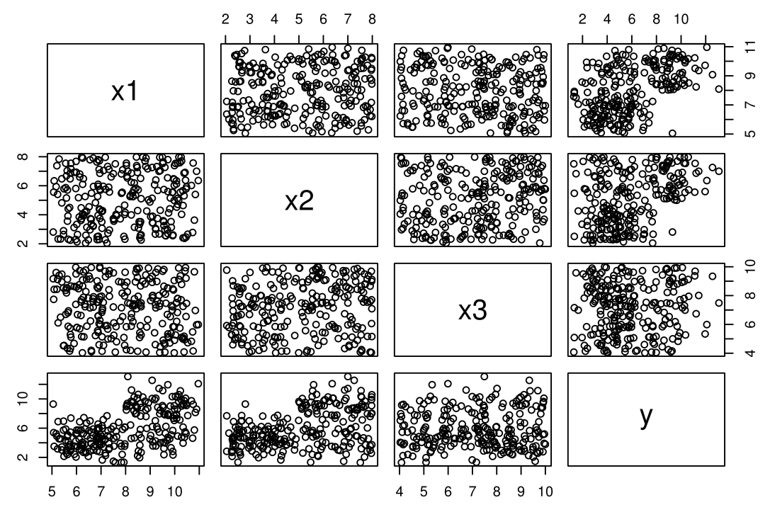
Toy dataset
N = 250

Slide 6
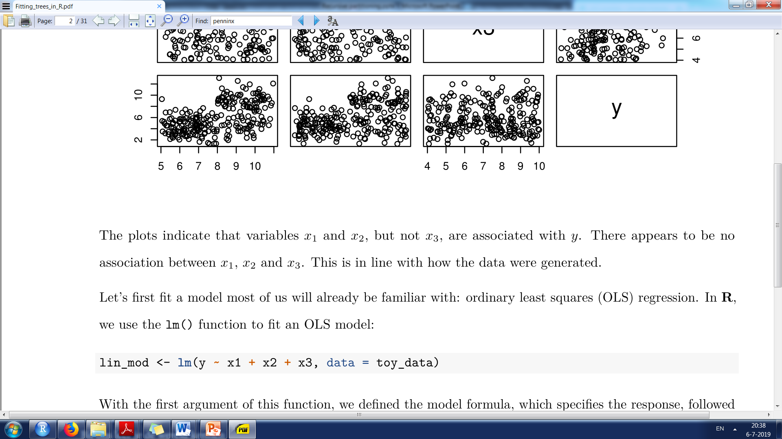
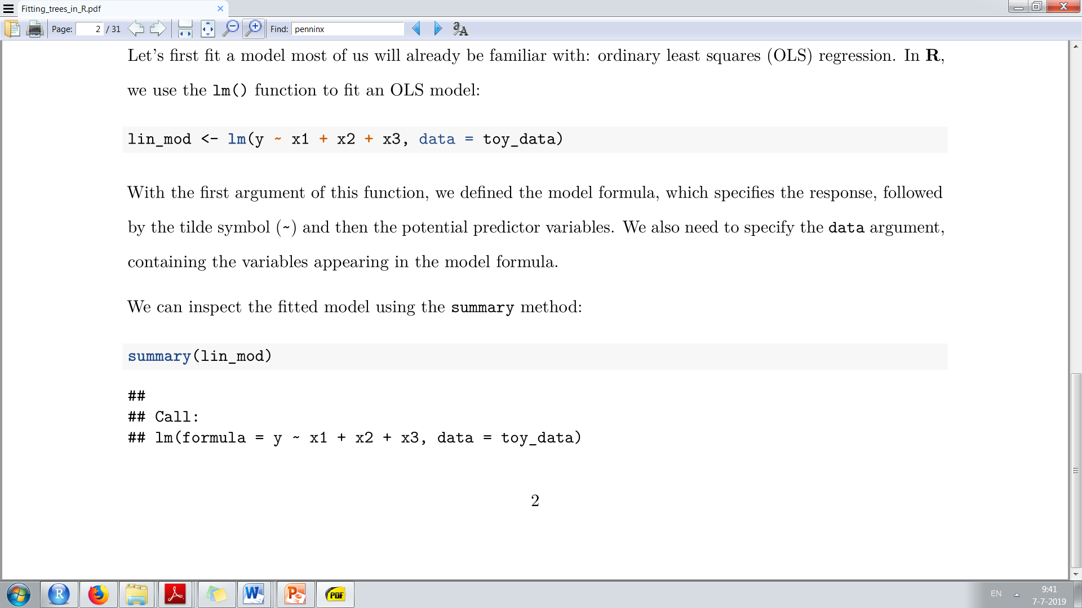
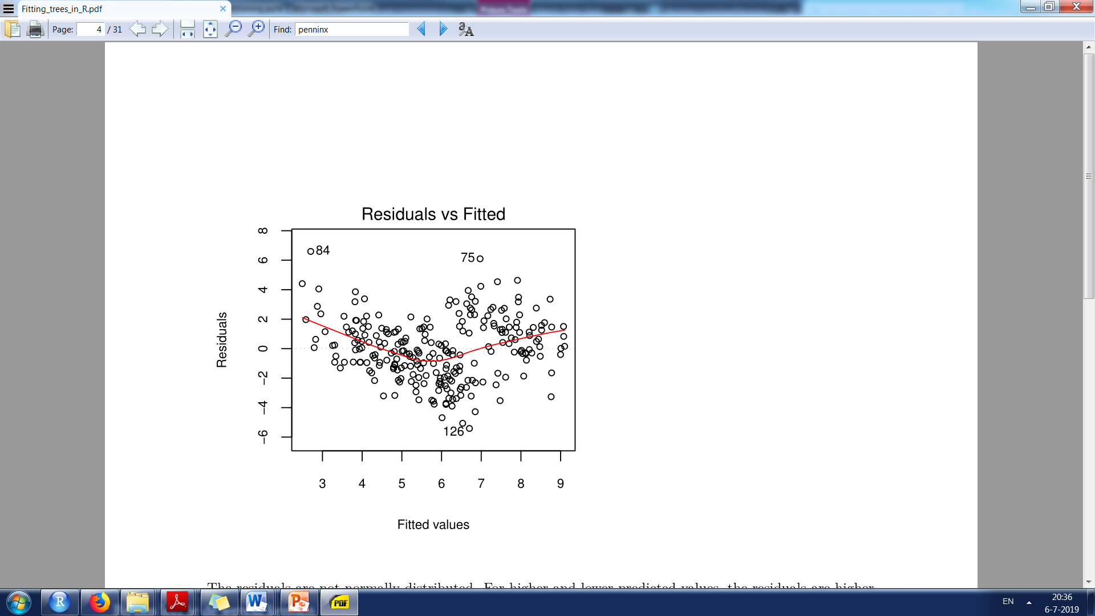
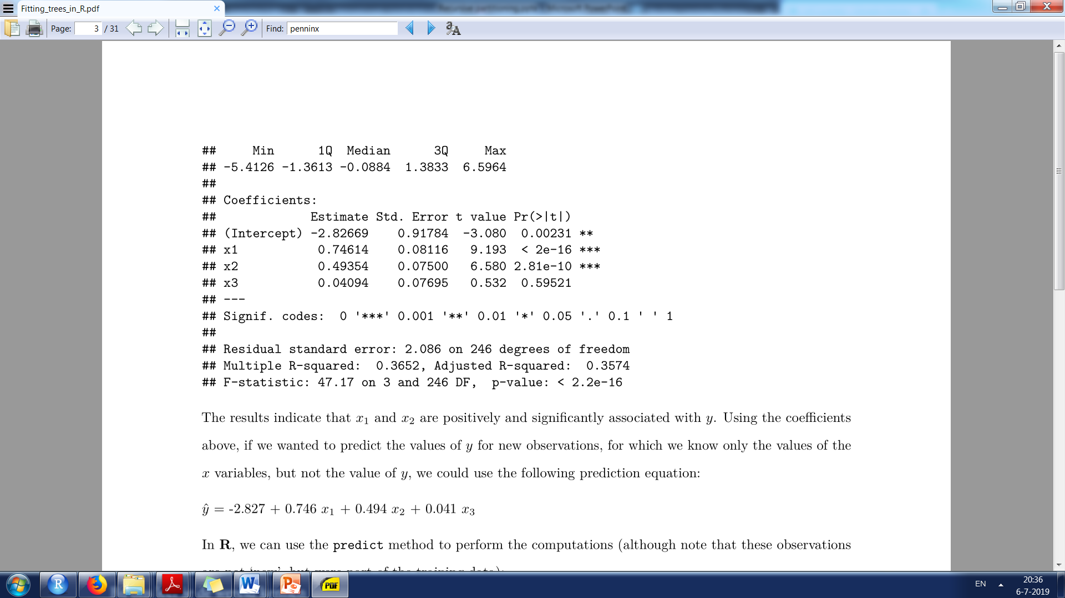
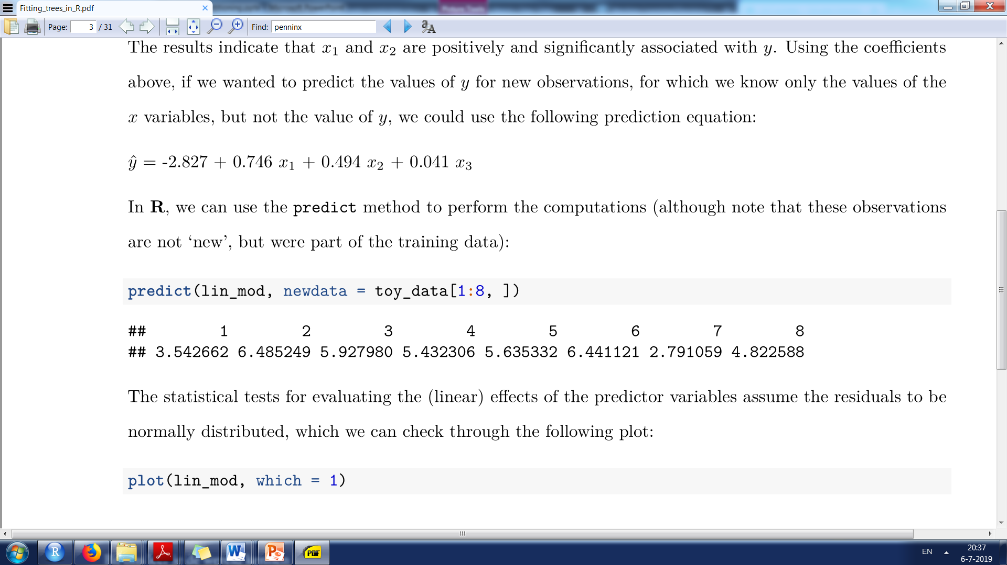
OLS regression model on toy data

Slide 7
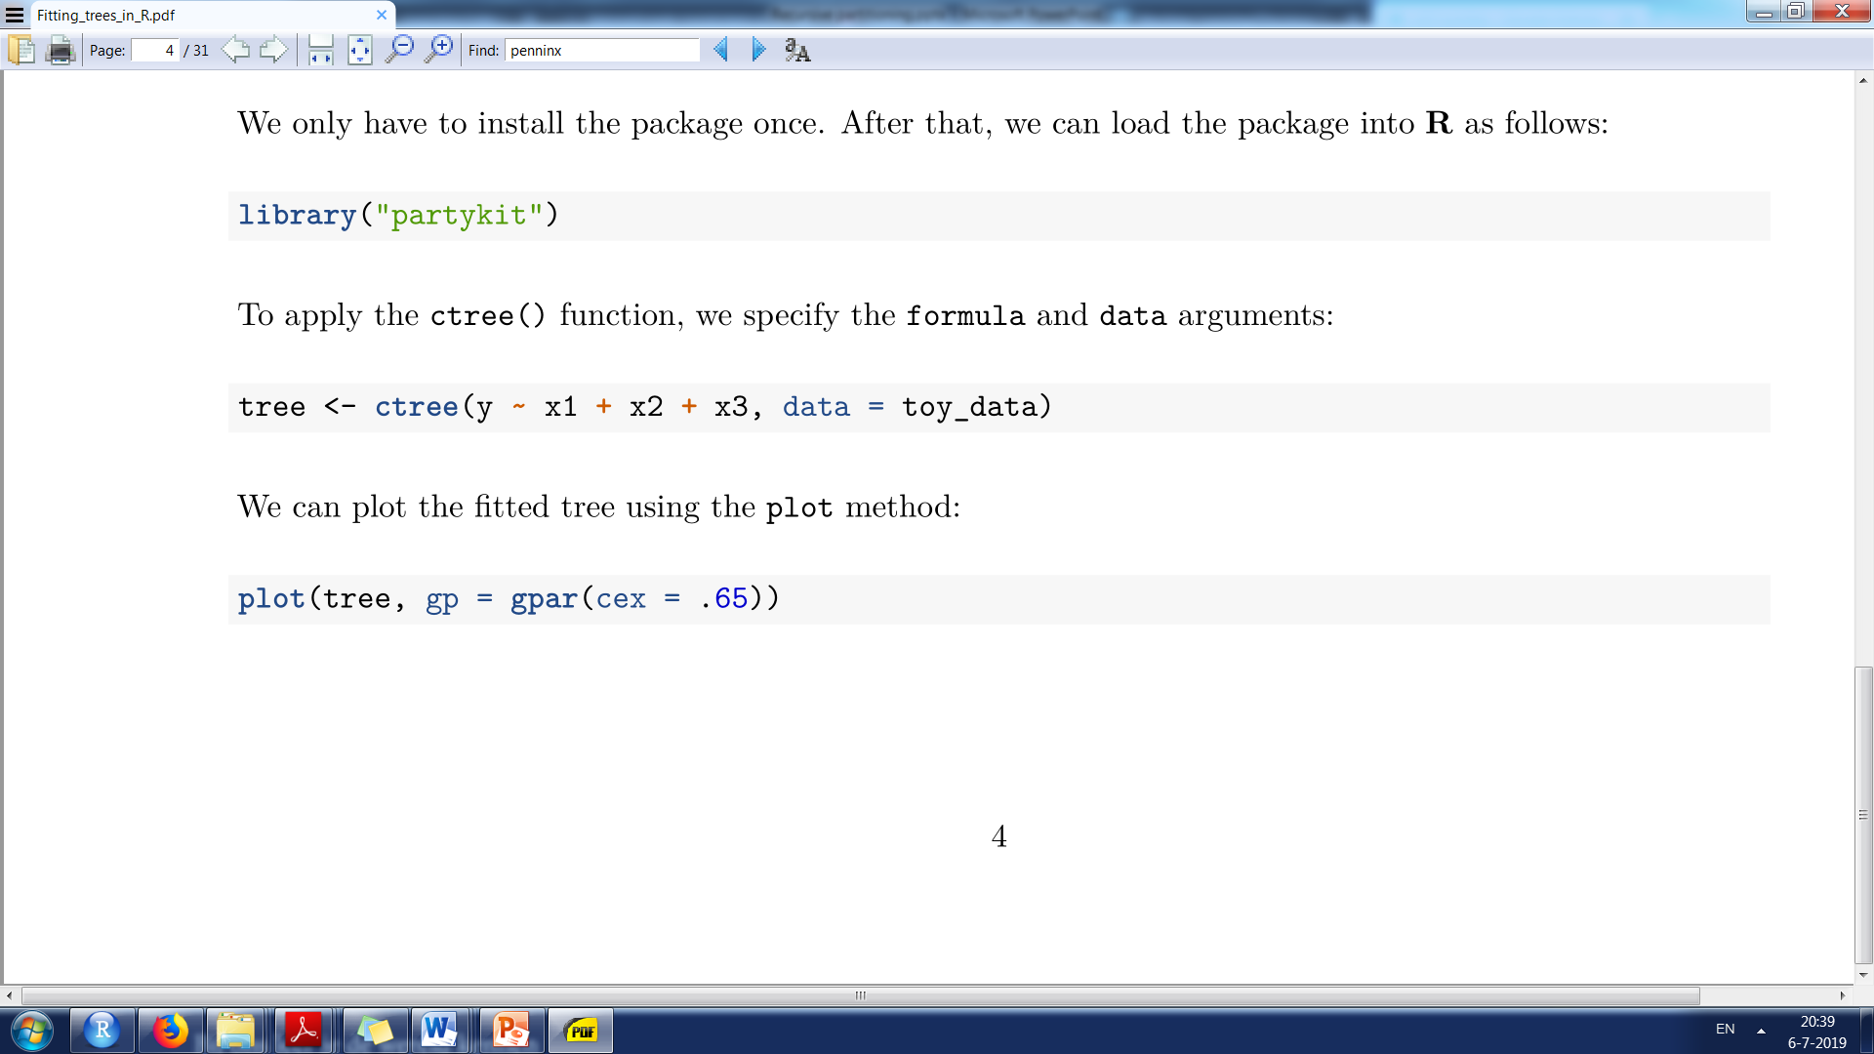
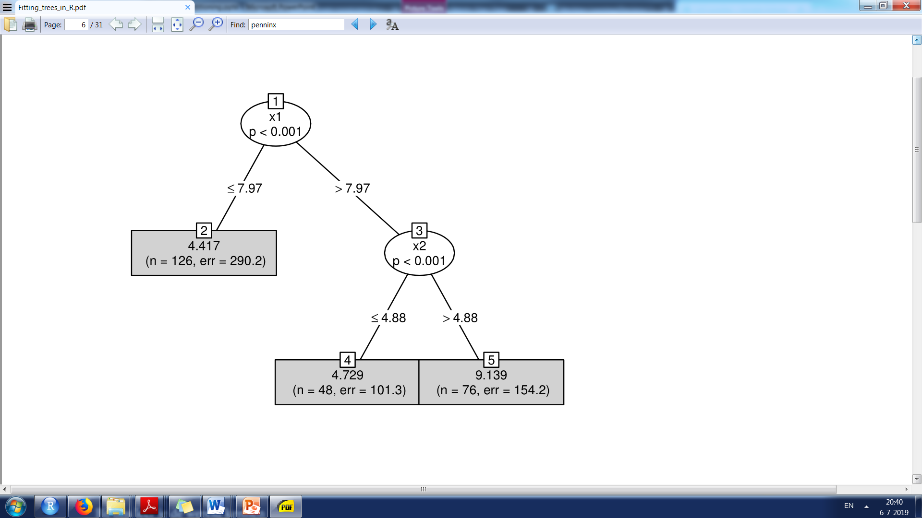
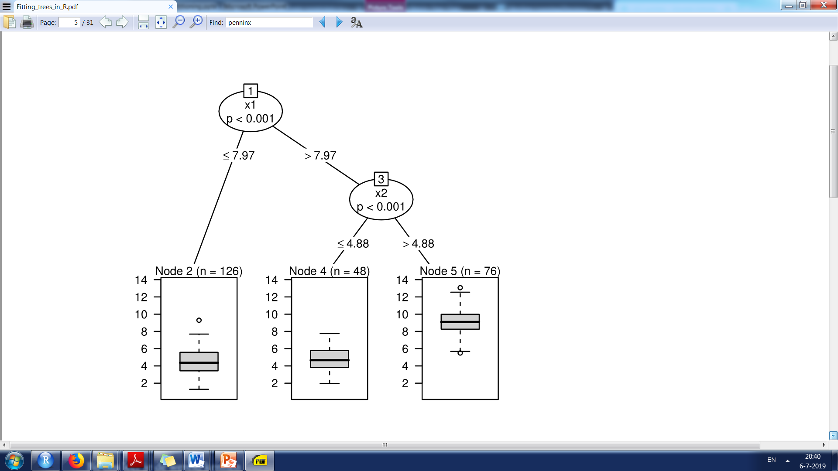
Regression tree on toy data

Slide 8
Split selection
Conditional inference tree algorithm (Hothorn, Hornik & Zeileis, 2006):
In current node, statistically test the association between partitioning variables and response. If at least one partitioning variable has p value ≤ α , variable with the lowest p value is selected for splitting.
Select the splitting value that minimizes loss function in the two resulting terminal nodes.
Repeat steps 1 and 2 in the two resulting nodes.
-> Separate selection of splitting variable (1) and value (2)
eliminates variable selection bias
-> Step 2 provides natural stopping criterion

Slide 9
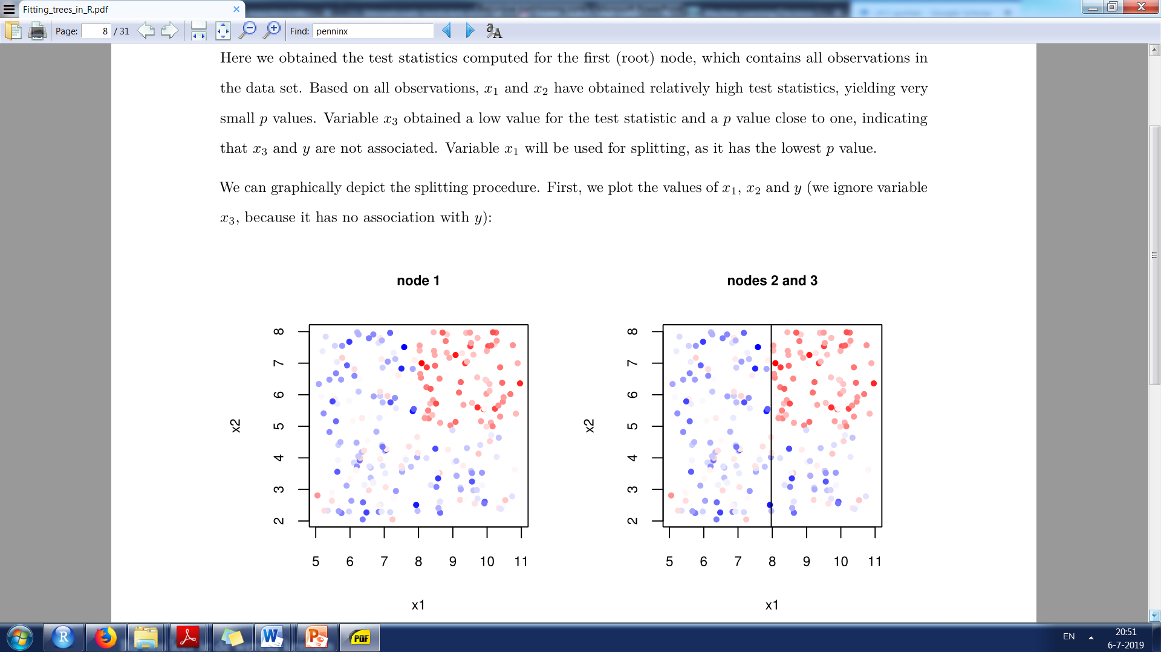

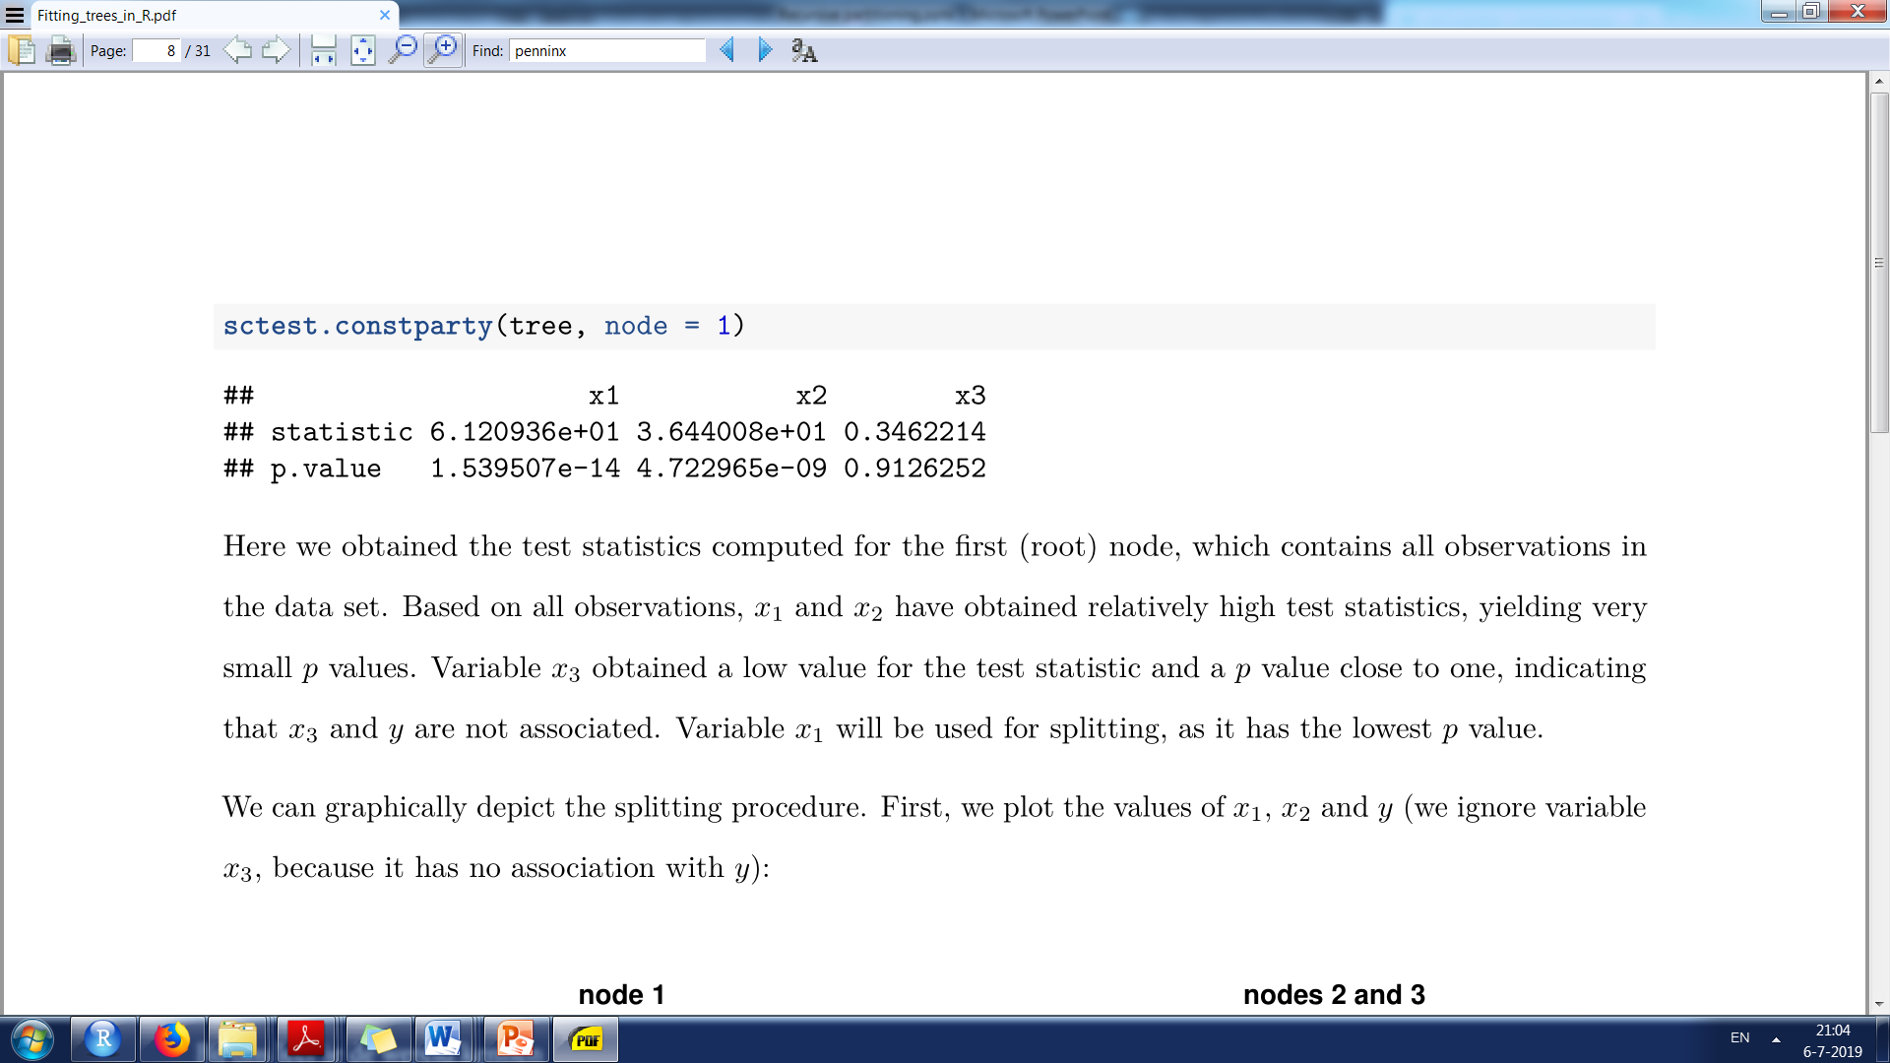

Slide 10
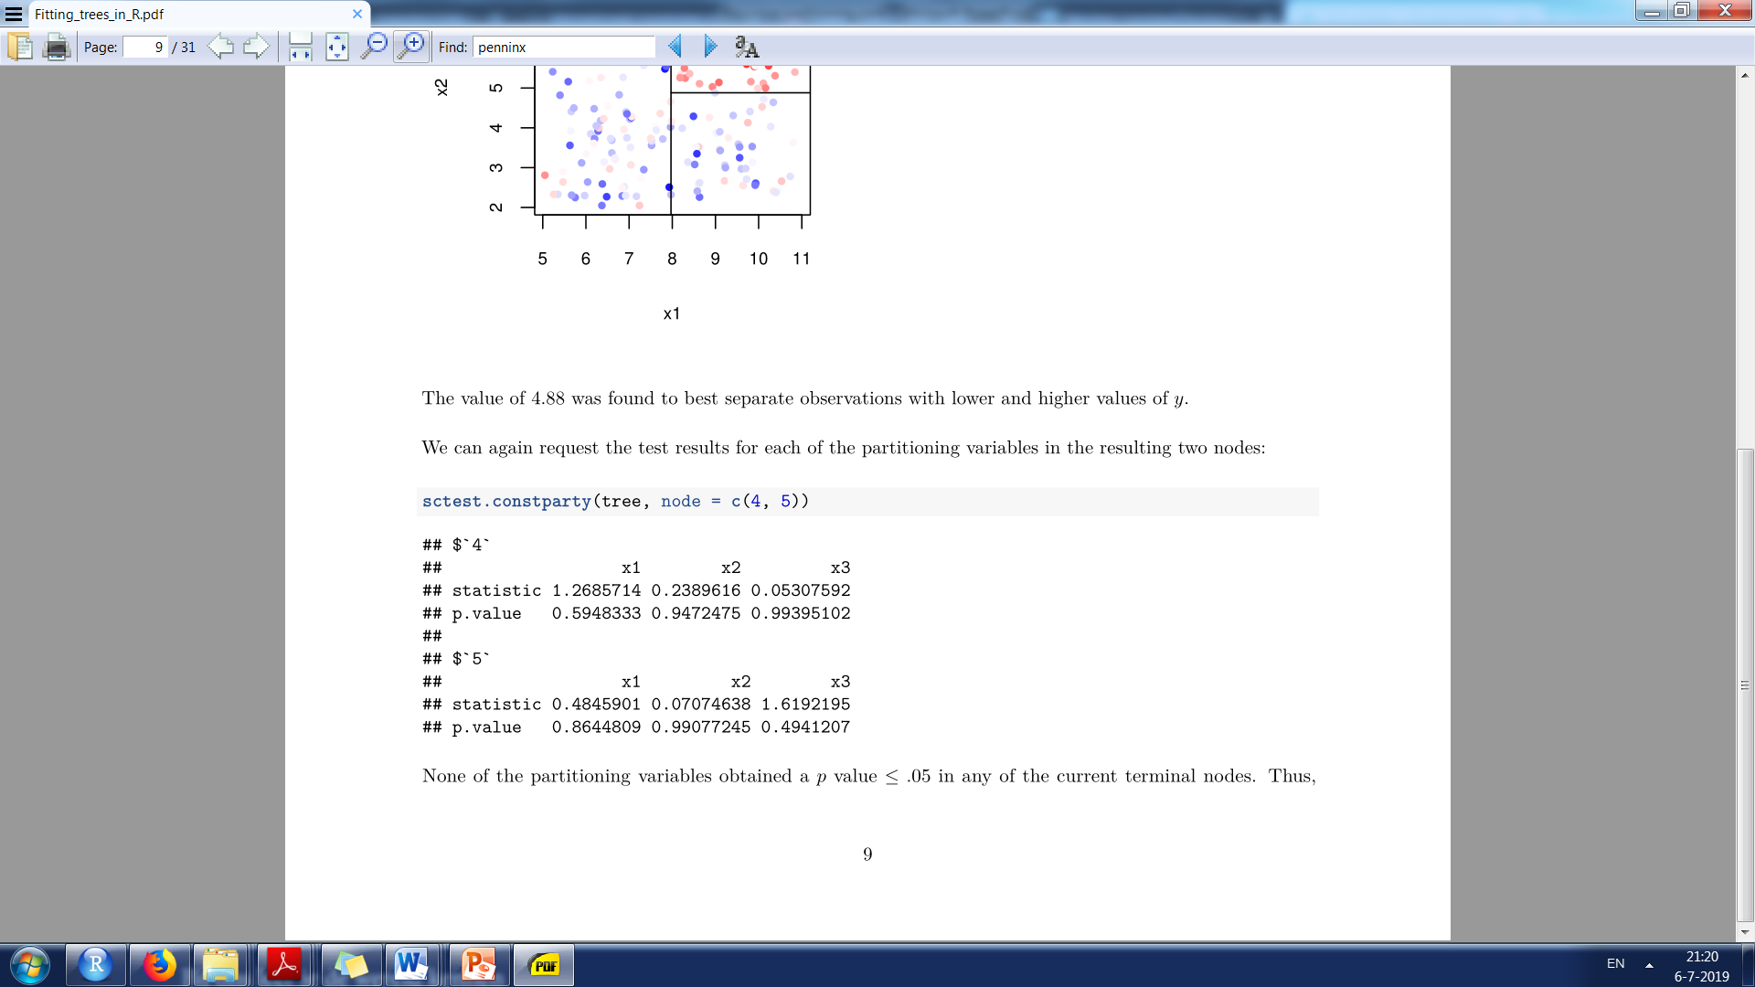
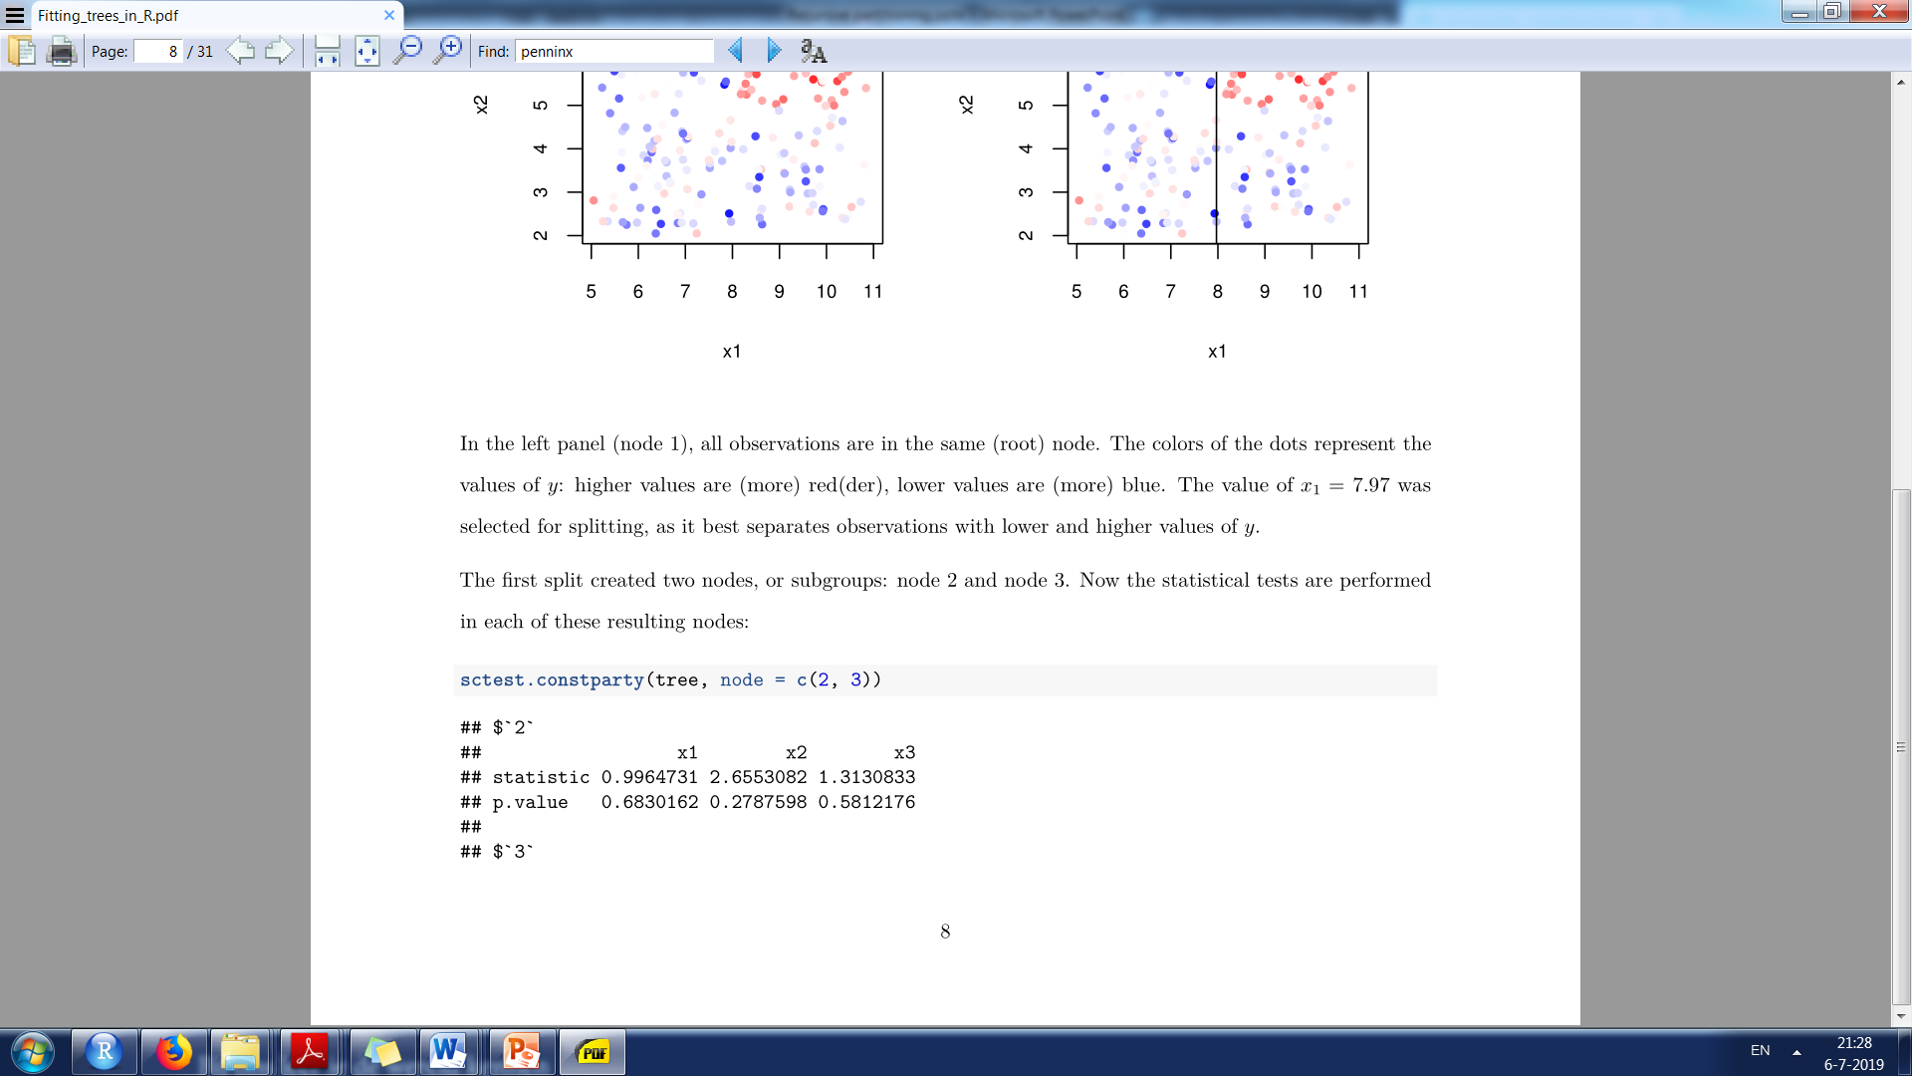
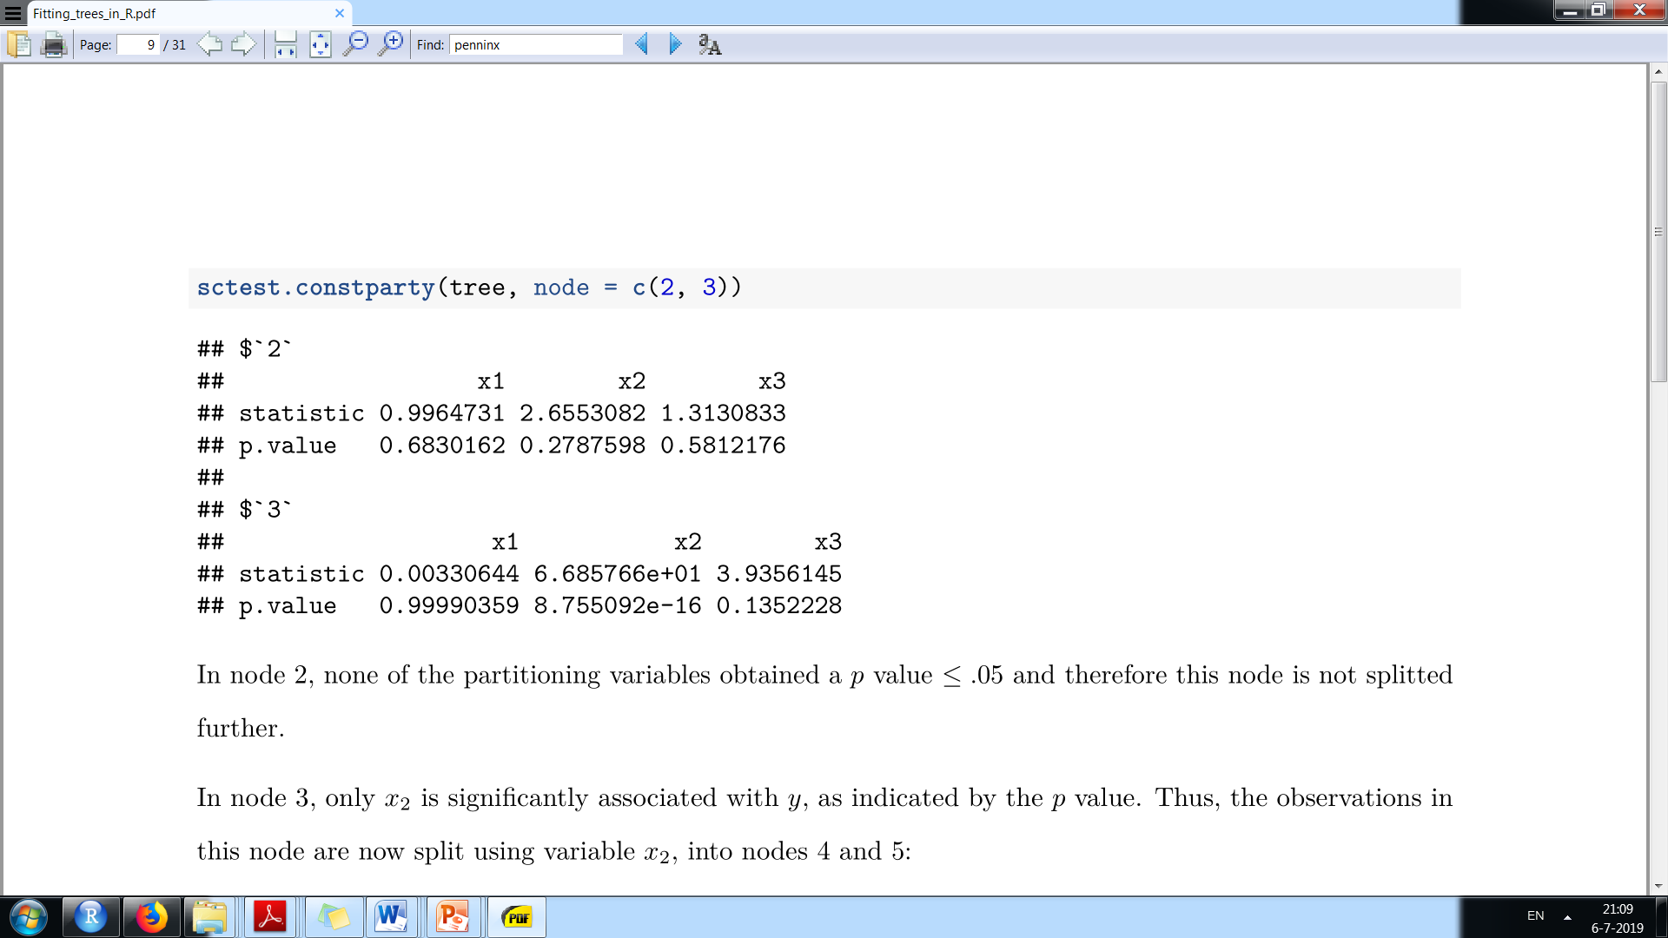

Slide 11
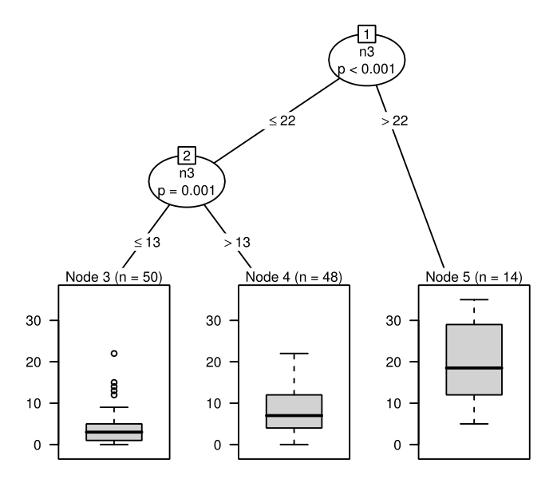
Regression tree example
Study by Carrillo et al. (2001):
Response: Beck Depression Inventory score
25 possible predictors:
NEO-PI-R facet and subscale scores
age, gender
N = 112 respondents

Slide 12
Classification tree example
Dataset modeled after study by Penninx et al. (2011) on chronicity of anxiety and depression
Sample: Respondents with current anxiety and/or depressive disorder (original N = 1,209; current N = 1,100)
Response: Presence of anxiety and/or depressive disorder diagnoses, 2 years after baseline
Possible predictor variables:
disType: baseline psychiatric status
gender, age, age of disorder onset, years of completed education.
IDS (depressive symptoms), BAI and FQ (anxiety symptoms)
LCImax: proportion of time in which symptoms of anxiety and depression were present in the four years prior to baseline
type of depressive disorder at baseline
type of anxiety disorder(s) at baseline
….

Slide 13
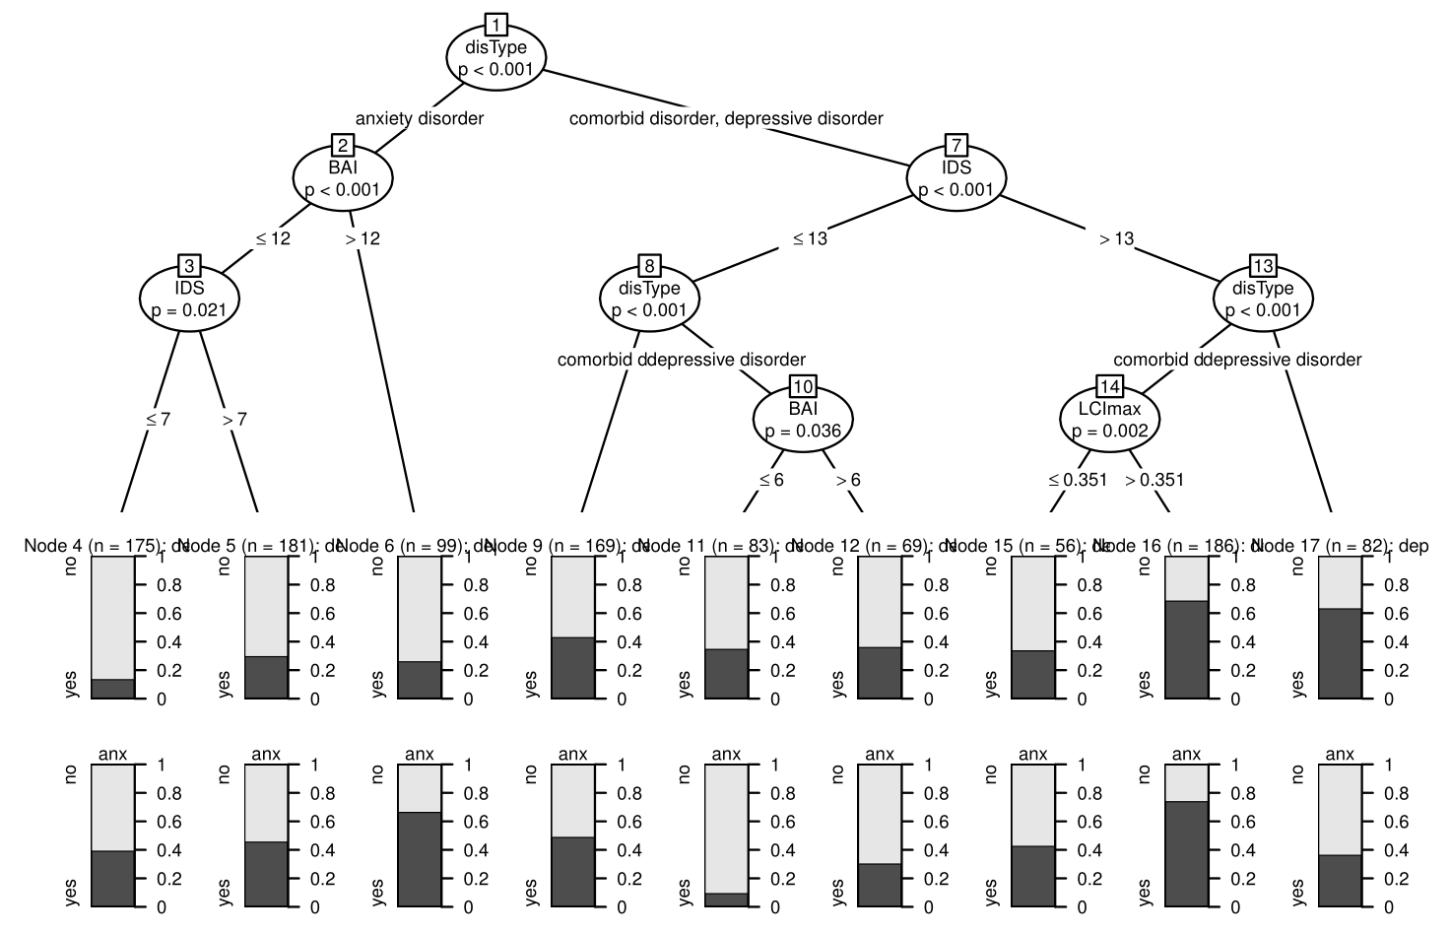
Classification tree example

Slide 14
Model-based recursive partitioning (MOB; Zeileis, Hothorn & Hornik, 2008)
Rationale: Global parametric model (e.g., LM / linear regression, GLM / logistic regression) may not fit data well.
Perhaps can find subgroups, defined by partitioning variables, with better-fitting local models.
MOB algorithm:
Fit parametric model to observations in current node. Perform a parameter stability test for each of the partitioning variables. If at least one of the partitioning variable has p value ≤ α , select variable with lowest p value for splitting.
Select splitting value that yields optimal fit when the parametric model is fitted in each of the resulting two nodes.
Repeat steps 1 and 2 in the two resulting nodes.

Slide 15
MOB example: Treatment subgroups
Data modeled after SMART data from the Improving Access to Psychological Therapies (IAPT) project (Lucock et al., 2017).
IAPT: Patients receiving mental-health services in the Northern UK. Non-random assignment to:
LI: low intensity treatment, e.g. guided self-help, computerized cognitive behavior therapy
HI: high intensity treatment, e.g. face-to-face psychological therapies
Aim of SMART: Identify patients who will benefit most from HI vs. LI treatment
-> Fit tree to detect predictors and moderators of treatment outcome

Slide 16
Treatment subgroups
Dataset contains 1,500 observations and 13 variables
Response: recovered (yes, no)
Predictor: treatment type (HI vs LI)
10 possible partitioning variables:
PHQ9_pre (baseline depression measure)
GAD7_pre (baseline symptoms of generalized anxiety disorder)
WSAS_pre (baseline work and social functioning)
Age, Gender, Ethnicity
Diagnosis
Employment status, Disability
Medication use
indicator for treatment center (will use later in the mixed-effects tree)

Slide 17
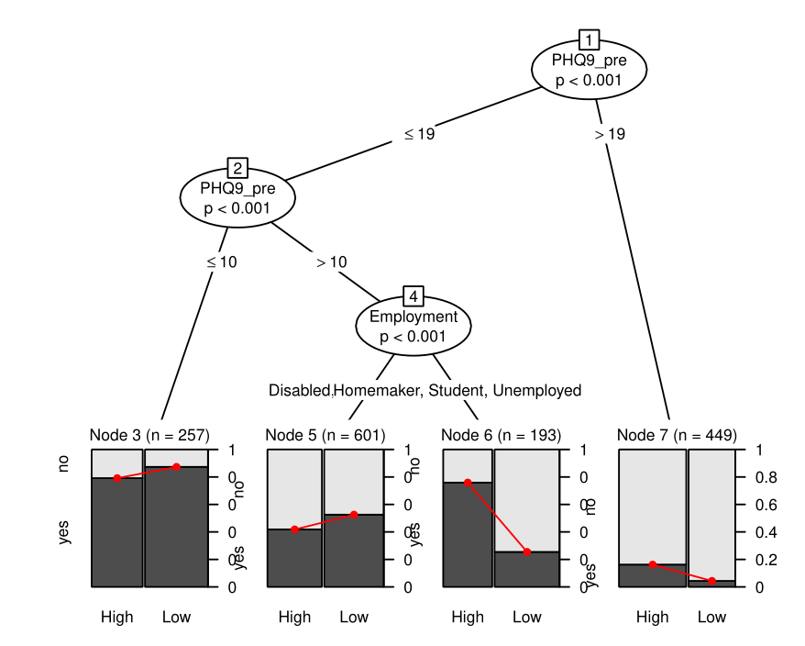
Treatment subgroups

Slide 18
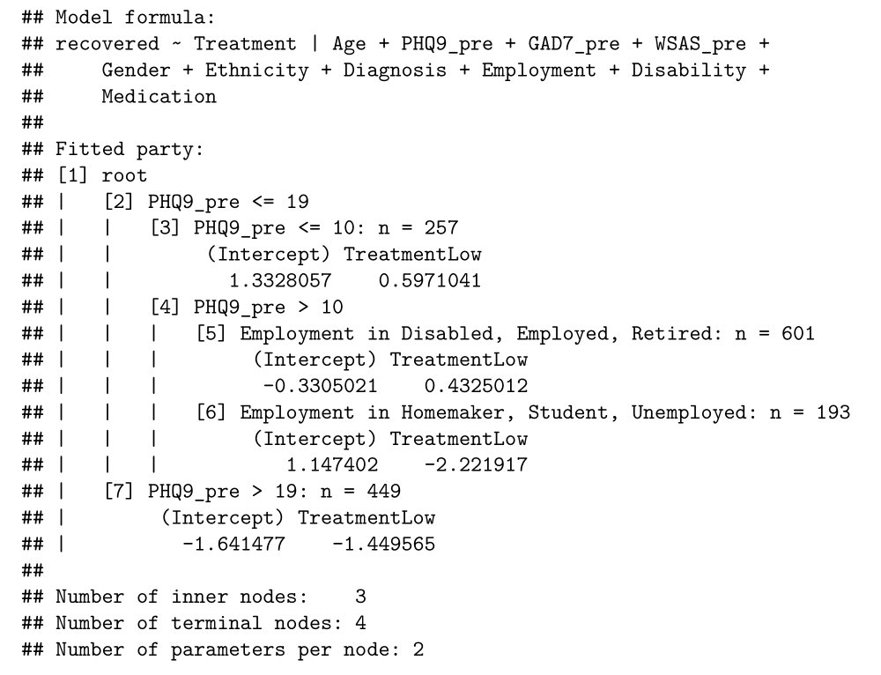
Local logistic regression models (GLM)

Slide 19
Dependent observations
Observations are known to be dependent in nested data, e.g.,
Multilevel data
Longitudinal data
Account for dependence by:
Estimating random effects and/or
Adjusting variable selection tests

Slide 20
Mixed-effects trees
Generalized linear mixed effect regression tree (glmertree; Fokkema et al. 2018):
Estimate local ‘fixed-effects’ models
That is: find subgroups and estimate local parameters
Globally estimate random effects
That is: using all observations

Slide 21
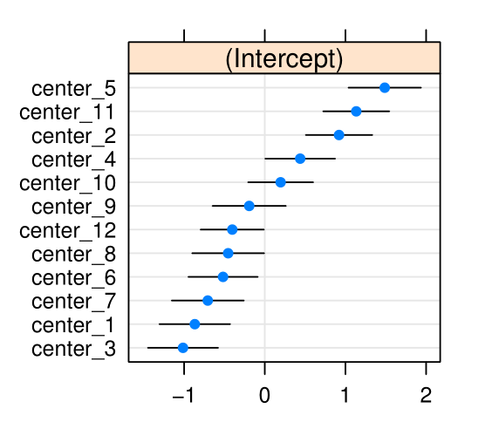
Mixed-effects tree example: Treatment subgroups with multilevel structure
+ random intercept w.r.t. treatment center:

Slide 22
Mixed-effects tree example: Subgroup detection in growth trajectories
Data: Subsample of N = 400 children from Early Childhood Longitudinal Study-Kindergarten (ECLS-K)
Response variable: theta (IRT ability) scores of reading skills
Predictor variable: time (square root of months since baseline)
Potential partitioning variables (baseline):
GENDER , RACE and AGE
WKSESL (measure of socio-economic status)
C1GMOTOR and C1FMOTOR (measures of gross and fine motor skills)
T1INTERN , T1EXTERN , T1INTERP and T1CONTRO (measures of internalizing, externalizing, interpersonal problems and self control)
Partitioning variables measured at level II, not individual observation level (level I) -> need to account in tests for variable selection

Slide 23
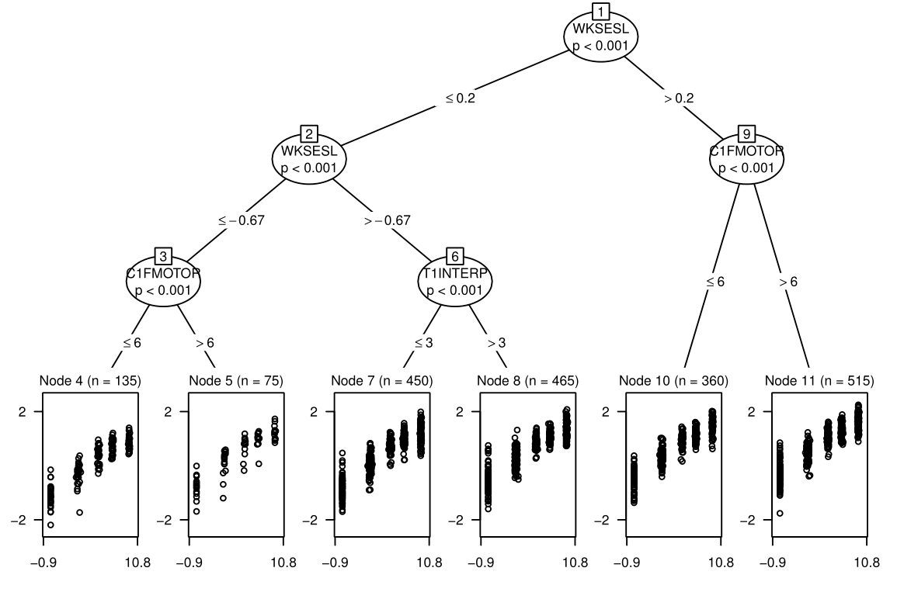
Mixed-effects tree example: Subgroup detection in growth trajectories

Slide 24
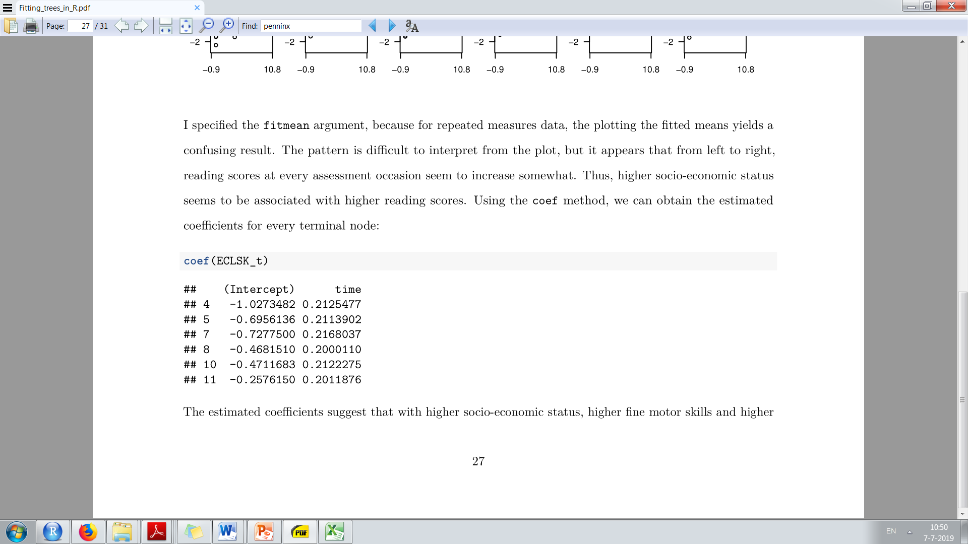
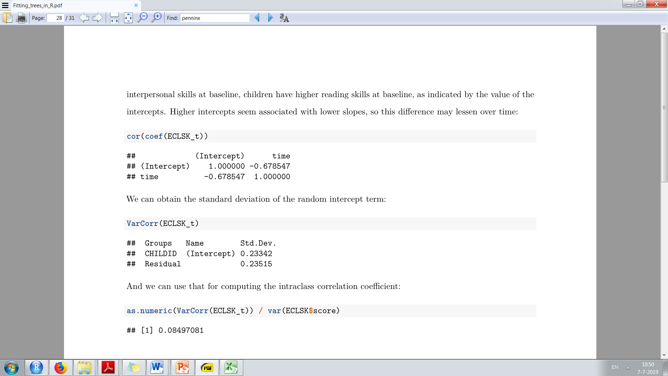

Slide 25
Concluding remarks
Go and create yourself some trees!
Manual for replicating examples is online (“Fitting_trees_in_R.pdf”)
I’m happy to answer questions now, during conference, or via m.fokkema@fsw.leidenuniv.nl

Slide 26
References
Breiman, L., Friedman, J., Olshen, R., & Stone, C. (1984). Classification and regression trees. New York: Wadsworth.
Carrillo, J. M., Rojo, N., Sanchez-Bernardos, M. L., Avia, M. D. (2001). Openness to experience and depression. European Journal of Psychological Assessment, 17(2), 130-136.
Fokkema, M., Smits, N., Zeileis, A., Hothorn, T. & Kelderman, H. (2018). Detecting treatment-subgroup interactions in clustered data with generalized linear mixed-effects model trees. Behavior Research Methods, 50(5), 2016-2034.
Hothorn, T., Hornik, K., Zeileis, A. (2006). Unbiased recursive partitioning: A conditional inference framework. Journal of Computational and Graphical Statistics, 15(3), 651-674.
Kass, G.V. (1980). An Exploratory Technique for Investigating Large Quantities of Categorical Data. Applied Statistics, 29(2), 119–127.
Lucock, M., Barkham, M., Donohoe, G., Kellett, S., McMillan, D., Mullaney, S., ... & Delgadillo, J. (2017). The role of Practice Research Networks (PRN) in the development and implementation of evidence: The Northern improving access to psychological therapies PRN case study. Administration and Policy in Mental Health and Mental Health Services Research, 44(6), 919-931.
Morgan, J. N., & Sonquist, J. A. (1963). Problems in the analysis of survey data, and a proposal. Journal of the American Statistical Association, 58, 415–434.
Penninx, B. W. J. H., Nolen, W. A., Lamers, F., Zitman, F. G., Smit, J. H., Spinhoven, P., ..., Beekman, A. T. F. (2011). Two-year course of depressive and anxiety disorders: Results from the Netherlands Study of Depression and Anxiety (NESDA). Journal of Affective Disorders, 133(1), 76-85.
Quinlan, J. R. (1986). Induction of decision trees. Machine Learning, 1(1), 81–106.
Quinlan, J. R. (1993). C4.5: Programs for machine learning. San Francisco: Kaufmann Publishers.
Zeileis, A., Hothorn, T., & Hornik, K. (2008). Model-based recursive partitioning. Journal of Computational and Graphical Statistics, 17(2), 492-514

